Slide 1
Chintan Shivir
Convergence of Government Programs
Ministry of Tourism
Government of India
29 Mar 2023 | Day 2

Slide 2
Convergence of Government Programs
Agenda
Many allied sectors for developing tourism Central Ministries
Budget FY 23 has laid key focus on convergence for development of tourism in Mission mode
Close partnership & Action Plan between Ministry of Tourism and above Ministries
States and Industry will provide their suggestions and feedback for effective convergence
How to leverage PM Gati Shakti portal for Tourism Planning, Development and Monitoring

Slide 3
Convergence of Government Programs
Major Deliberations with Central Ministries in FY 22-23
Sl No | Major Meetings/ Events | Date | Agenda
1 | Consultative Meeting with Union Ministers on Draft National Tourism Policy | June’23 | Feedbacks on draft Policy
2 | Dharamshala Declaration | Sep’22 | Set Targets for Amrit Kaal and Collective Action
3 | Review by PM Advisor on convergence in Skilling & Entrepreneurship | Jan’23 | Pre-Budget consultative meeting
4 | Post Budget Webinar | 3rd Mar’23 | Post-Budget consultative meeting
5 | Chintan Shivr | 29th Mar’23 | Action Plan for Joint Partnership in identified programmes

Slide 4
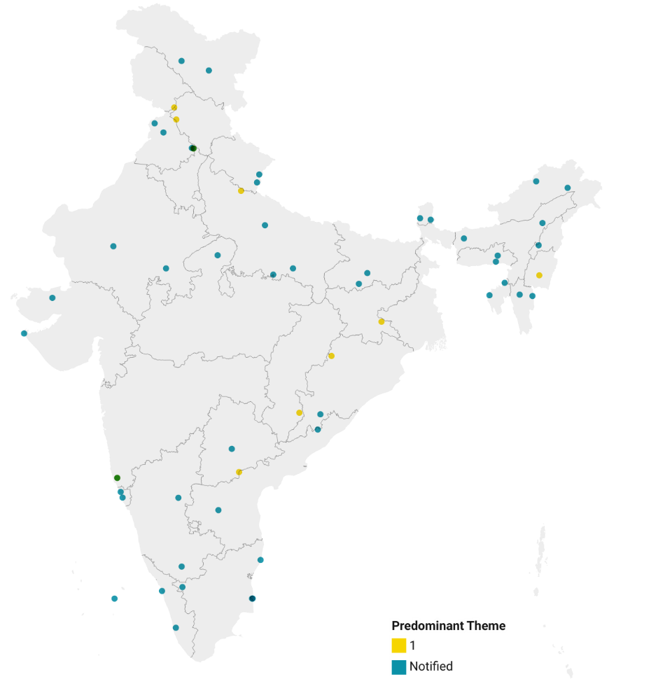
Convergence of Government Programs
Kargil
Leh
Focussed Development at Destinations
Basholi
Amritsar
Pong Dam
Kapurthala
Panchkula
Pithoragarh
Mechuka
Focus on Important Tourist Destinations
The Ministry of Tourism provides funding for development destinations and attractions through
Swadesh Darshan 2.0 – 55 Destinations
PRASHAD
Financial Assistance to Central Agencies
Effective Convergence is required for holistic development of the destinations
Kurukshetra
Champavat
Bomjir
Gyalshing
Gangtok
Jodhpur
Naimisharanya
Jorhat
Prayagraj
Kokrajhar
Unnakoti
Nalanda
Sohra
Gwalior
Shillong
Moirang
Dholavira
Bundi
Chitrakoot
Agartala
Gaya
Aizwal
Champhai
Chandil
Dwarka
Bilaspur
Debrigarh
Ajanta Ellora
Jagdalpur
Koraput
Bhongir
Araku- Lambassingi
Sindhudurg
Hampi
Porvorim
Colva
Gandikota
Mysuru
Mamallapuram
Kozhikode
Puducherry
Lakshadweep
The Nilgiris
Karaikal
Kumarakom

Slide 5
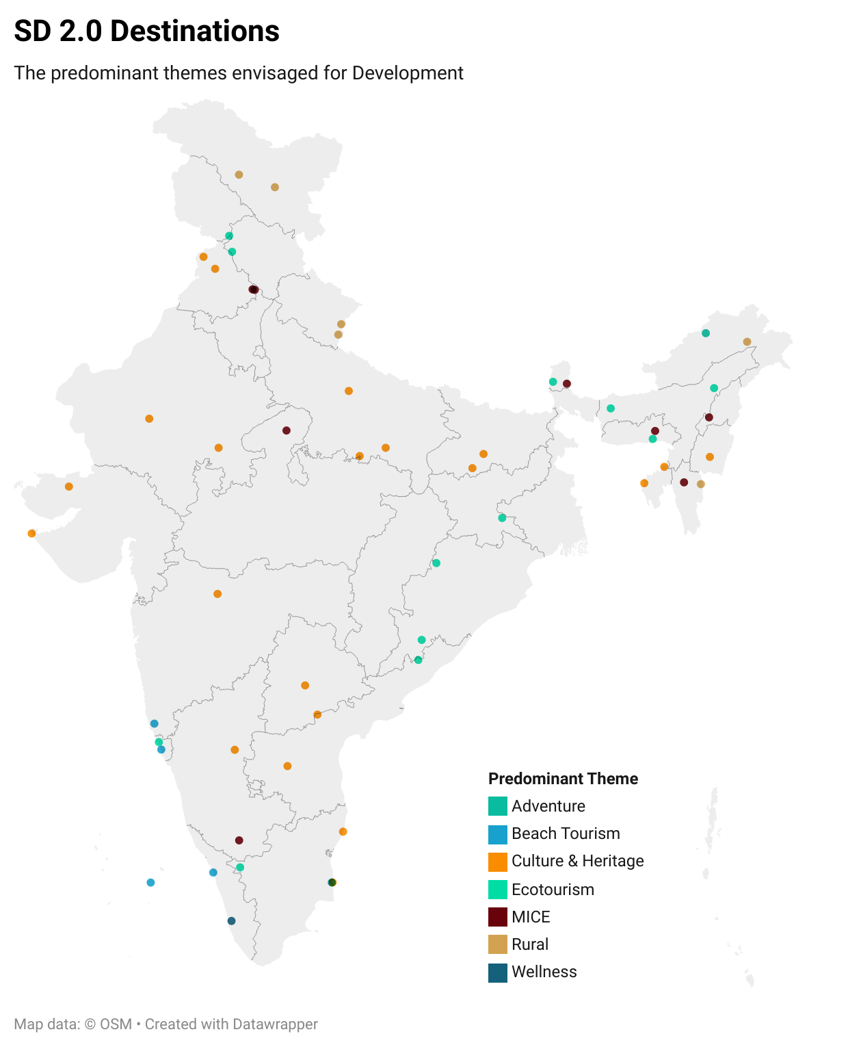
Convergence of Government Programs
Kargil
Leh
Convergence in Swadesh Darshan Scheme
Basholi
Amritsar
Pong Dam
Kapurthala
Panchkula
Pithoragarh
Mechuka
Destinations spread across various themes- predominantly in Heritage (40%), Eco & adventure (15%) and Beach (10%)- bound by Statutory compliances & regulations
Offbeat, rural and ecotourism destinations- needs ancillary tourism & trunk infrastructure
Popular tourist destinations & cities- need ample supporting civic infrastructure and connectivity
Kurukshetra
Champavat
Bomjir
Gyalshing
Gangtok
Jodhpur
Naimisharanya
Jorhat
Prayagraj
Kokrajhar
Unnakoti
Nalanda
Sohra
Gwalior
Shillong
Moirang
Dholavira
Bundi
Chitrakoot
Agartala
Gaya
Aizwal
Champhai
Chandil
Dwarka
Bilaspur
Debrigarh
Ajanta Ellora
Jagdalpur
Koraput
Bhongir
Araku- Lambassingi
Sindhudurg
Hampi
Porvorim
Colva
Gandikota
Mysuru
Mamallapuram
Kozhikode
Puducherry
Lakshadweep
The Nilgiris
Karaikal
Kumarakom

Slide 6
Convergence of Government Programs
Convergence in Swadesh Darshan Scheme
Broad basing the Central Sanctioning Monitoring Committee and Mission Directorate with representation of Central Ministries and Industry in
Selection of Destinations
Approval of Destination Master Plans, Strategy and Action Plans
Approval of Detailed Project Reports
Sanction
Partnerships/ MoU on
Arth Ganga
Destination Cleanliness with SBM
Other Destination improvement and supporting framework conditions

Slide 7
Convergence of Government Programs
Broad Convergence Areas
Session 7 Connectivity and Infrastructure
Session 8 Development of Tourism Products and Experiences
Session 9 Skill and Entrepreneurship

Slide 8
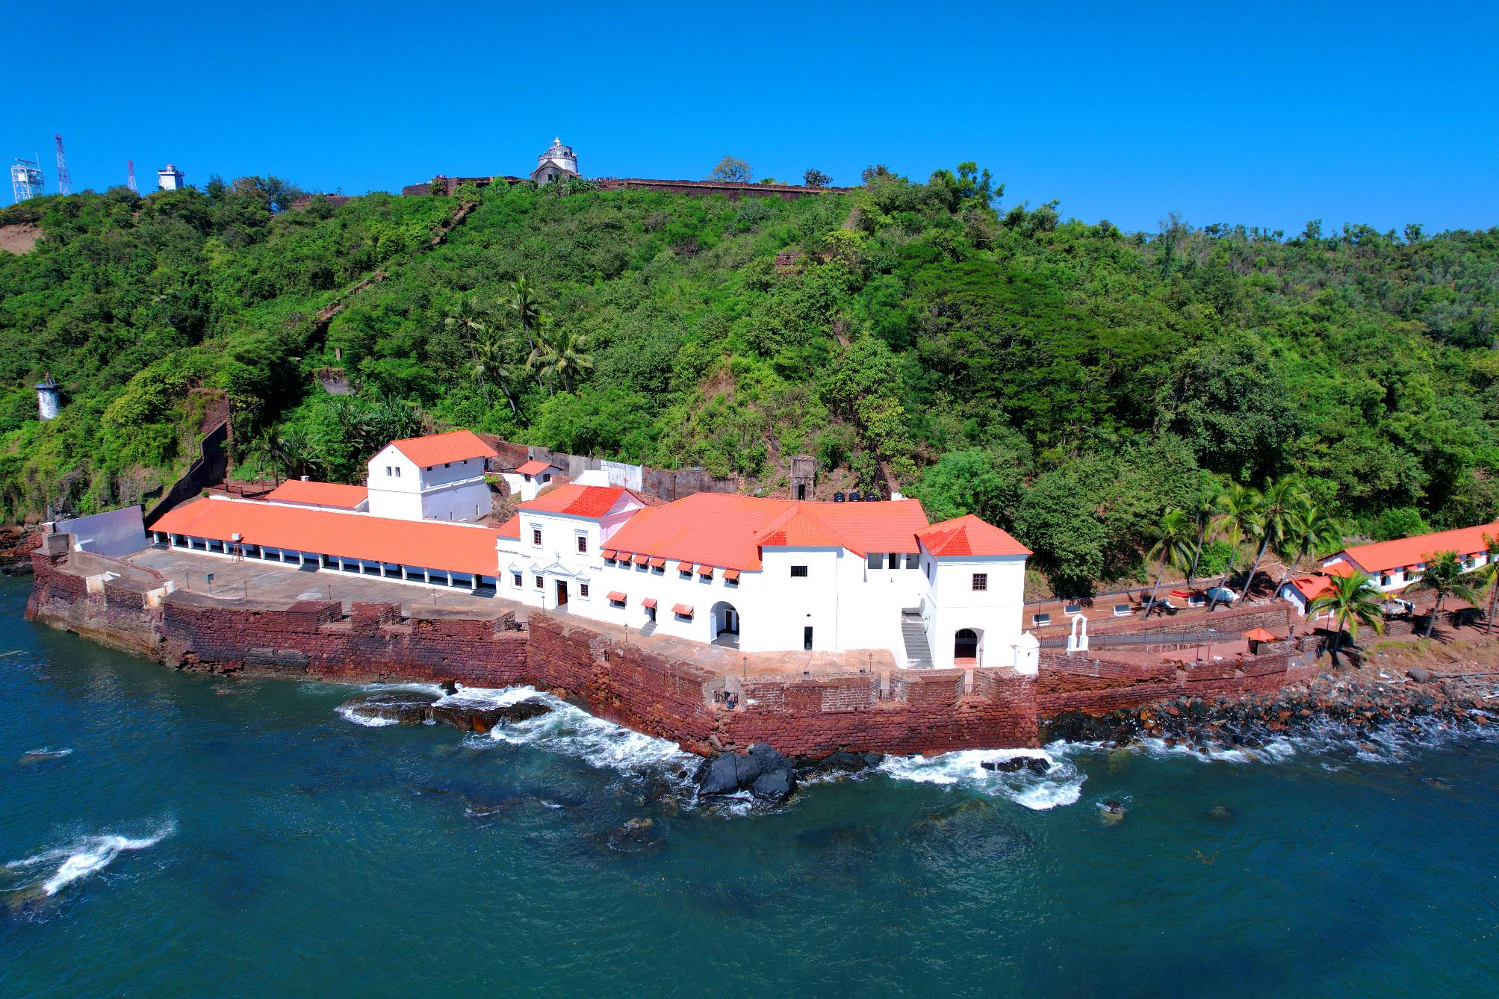
Session 7 Connectivity and Infrastructure
Aguada Jail, Goa
#Swadesh Darshan Scheme

Slide 9
Convergence of Government Programs
#1 Connectivity and Infrastructure
Ministry of Civil Aviation - Providing national and international connectivity
Sn | Area of Convergence | Proposed Action Items | Status
1 | International Connectivity | (i) Direct connectivity to strategic source markets | To be assessed
2 | Development of New Airports | (ii) Airports at new emerging / priority destinations may be assessed (NE/ Buddhist/ Islands/ Himalayan Region) | To be assessed
3 | Connectivity to Remote Areas | (iii) RCS UDAAN - Operationalisation of Air Strips (iv) Helicopter Service | 89/132 Routes Awarded 47 operationalised
4 | Aero Sports | (v) Development of Aerosports at identified destinations | To be discussed
5 | Staff Sensitisation | (vi) Conducting sensitisation initiatives | To be assessed

Slide 10
Convergence of Government Programs
#1 Connectivity and Infrastructure
Ministry of Road, Transport, & Highways- Road connectivity to the Destinations
Sn | Area of Convergence | Proposed Action Items | Status
1 | NH Connectivity | 100% NH Connectivity to identified 50 Sd 2.0 Destinations. | To be assessed
2 | Last Mile form NH | Providing Last Mile connectivity | To be assessed
3 | Wayside Amenities | Development of WS at major tourism routes | To be assessed
4 | View points | Development of Viewpoints & WS Amenities in NE Region | To be assessed
5 | Ropeways | Parvatmala: Ropeways development to promote tourism | 8 Projects Identified. 7under tendering stage

Slide 11
Convergence of Government Programs
#1 Connectivity and Infrastructure
Ministry of Ports, Shipping, & Waterways- Developing Port Infrastructure for cruise tourism
Sn | Area of Convergence | Proposed Action Items | Status
1 | Cruise Terminals | (i) Development & Modernisation of Cruise Terminals | 3 Operational 4 under development
2 | Immigration / E Visa | (ii) Visa on arrival, e Landing Card, | Addressed
3 | Rates / Duty | (iii) Rationalisation of applicable charges on Cruise Ships | To be assessed
4 | Promotion | (iv) Joint Promotion and Marketing Initiatives | To be assessed
5 | Light House Tourism | (v) Development of Light House as Tourism Products | To be assessed
6 | Staff Sensitisation | (vi) Conducting sensitisation initiatives | To be assessed

Slide 12
Convergence of Government Programs
#1 Connectivity and Infrastructure
Ministry of Railways - Developing Rail Connectivity and Infrastructure
Sn | Area of Convergence | Proposed Action Items | Status
1 | Railway Connectivity | (i) Enhancement of connectivity | To be assessed
2 | Station Development | (ii) Development / Upgradation of RS at Tourist Destinations | To be assessed
3 | Staff Sensitisation | (iii) Conducting sensitisation initiatives | To be assessed

Slide 13
Convergence of Government Programs
#1 Connectivity and Infrastructure
Ministry of Housing and Urban Affairs – Civic Infrastructure
Sn | Area of Convergence | Proposed Action Items | Status
1 | Sanitation & Hygiene | (i) Convergence on SD 2 Destinations on interventions / ranking through SBM Urban and Rural. | To be assessed
2 | Water Supply | (ii) 100% coverage of tourist zones through AMRUT, Smart Cities and CITIIS | To be assessed
3 | Waste Management | (iii) 100% SWM and Water Treatment at Tourist Destinations | To be assessed
4 | Non motorised transport | (iv) Efficient non motorised local transportation in tourism zones | To be assessed
5 | Green Spaces/ Parks | (v) Development of 100% green spaces at SD 2 touist destinations | To be assessed

Slide 14
Thank You

Slide 15
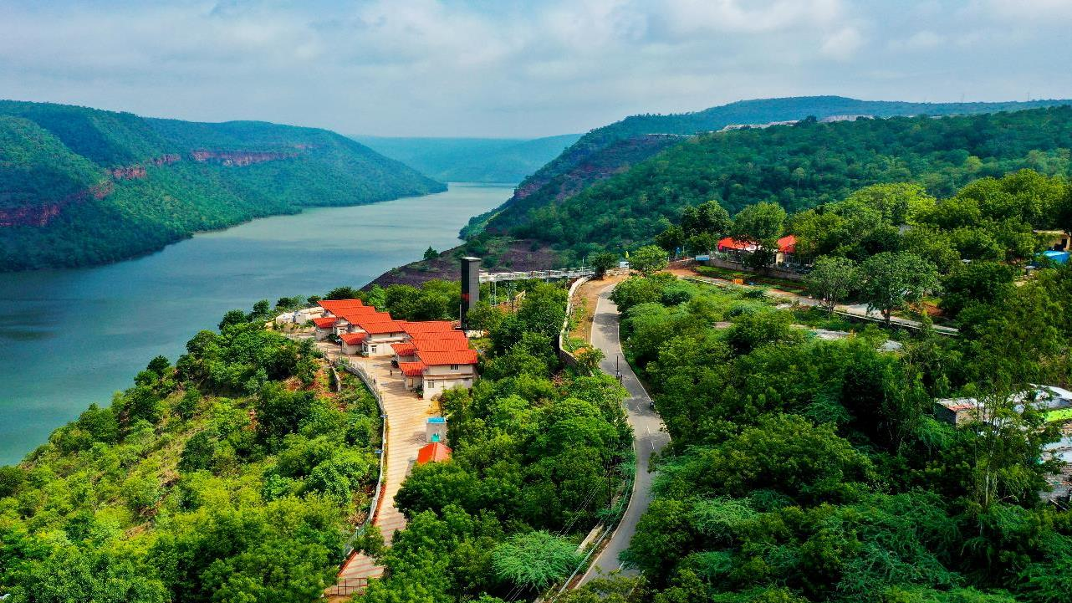
Session 8 Tourism Products and Experiences
Egalapanta, Telangana
#Swadesh Darshan Scheme

Slide 16
Convergence of Government Programs
#2 Developing Tourism Products and Experiences
Ministry of Culture/ ASI - Development of tourist amenities at ASI protected monuments
Sn | Area of Convergence | Proposed Action Items | Status
1 | Central Protected Monuments | (i) Preservation and Promotion of Assets. Convergence at these sites with SD and PRASAD intervations. | To be assessed
2 | Adopt a Heritage | (ii) Enabling adoption of assets for professional O&M through CSR funding | To be assessed
3 | Museum | (iii) Development through Museum Grant Scheme | To be assessed
4 | Intangible Heritage | (iv) Preservation and Promotion of Intangible Heritage | To be assessed

Slide 17
Convergence of Government Programs
#2 Developing Tourism Products and Experiences
Ministry of Environment, Forest, and Climate Change- Development of Eco-tourism
Sn | Area of Convergence | Proposed Action Items | Status
1 | Ecotourism | (i) Development of ecotourism at Sd 2 destinations. | To be assessed
2 | Ramsar Sites | (ii) Convergence on development and promotion of Ramsar sites as ecotourism destinations. | To be assessed
3 | Private Sector Involvement | (iii) Asses potential avenues for attracting private investment in sustainable ecotourism development | To be assessed

Slide 18
Convergence of Government Programs
#2 Developing Tourism Products and Experiences
Ministry of Health & Family Welfare- Promotion of Medical Value Travel
Sn | Area of Convergence | Proposed Action Items | Status
1 | Promoting Medical tourism, Wellness tourism | Need to build a resilient and sustainable MVT framework Heal in India Campaign | Demand for traditional medicine –Ayurveda

Slide 19
Convergence of Government Programs
#2 Developing Tourism Products and Experiences
Ministry of Railways - Bharat Gaurav Trains and Luxury Trains
Sn | Area of Convergence | Proposed Action Items | Status
1 | Improving high speed rail connectivity between destinations | Augmenting routes under Vande Bharat trains | 10 routes operationlised
2 | Promoting popular tourist circuits | Augmenting routes under Bharat Gaurav trains | 30 trips covering 24 circuits operationalised

Slide 20
Convergence of Government Programs
#2 Developing Tourism Products and Experiences
Ministry of Rural Development- SPMRM, Rural Tourism and Rural Homestays
Sn | Area of Convergence | Proposed Action Items | Status
1 | Skilling tourism dependent communities in rural areas | Training through DDU-GKY and Rural Self Employment Training Scheme on hospitality skillsets | Notional budget of Rs 30 Cr kept for skilling tourism sector skills annually
2 | Providing Rural amenities, connectivty and infrastructure | Strengthening road connectivity can be implemented through Pradhan Mantri Gram Sadak Yojana (PMGSY) and providing amenities under RURBAN | To be assessed.

Slide 21
Convergence of Government Programs
#2 Developing Tourism Products and Experiences
Ministry of Jal Shakti
Sn | Area of Convergence | Proposed Action Items | Status
1 | Rejuvenation of Rivers to promote Hinterland Tourism | Promotion of Cultural heritage and tourism by development of small local tourism and cultural circuit under the Arth Ganga mission | MoU engaged Prayagraj selected under SD 2.0
2 | Promoting Tourism at Reservoirs | (i) Reservoirs and its beds to be developed as recreation hubs for water sports and leisure | 5+ destinations selected in SD 2.0

Slide 22
Thank You

Slide 23
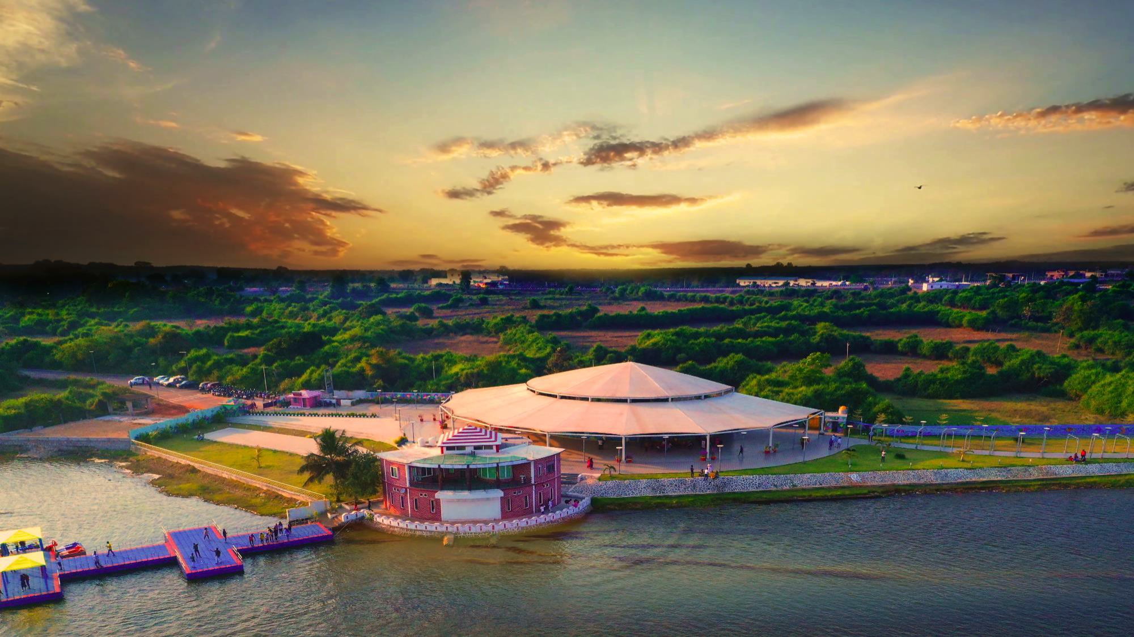
Session 9 Skills & Entrepreneurship

Slide 24
Convergence of Government Programs
#3 Skills & Entrepreneurship
Tourism has the potential to impact lives of people at the grassroot level working at the bottom of the pyramid
Focus on convergence across major initiatives & schemes in skilling and capacity building initiatives of Govt. of India, that is
Directly promoting jobs and employment opportunities in Tourism
Imparting Training & Skillset for tourism dependent workforce and communities
Promotion of MSMEs, SHGs and Micro Enterprises in tourism and hospitality sector

Slide 25
Convergence of Government Programs
#3 Skills & Entrepreneurship
Skill Development & Entrepreneurship
Sn | Area of Convergence | Proposed Action Items | Status
1 | Skilling programmes for tourism and hospitality job roles | Identifying new job roles in Pradhan Mantri Kaushal Vikas Yojana 4.0 | 2 Lakh+ trained beneficiaries in Tourism

Slide 26
Convergence of Government Programs
#3 Skills & Entrepreneurship
Ministry of Micro, Small and Medium Enterprises
Sn | Area of Convergence | Proposed Action Items | Status
1 | Credit line scheme for tourism service providers | Making Credit Guarantee Fund Trust for Micro and Small Enterprises (CGTMSE) affordable and accessible to tourism service providers of identified destinations | For Tourism Sector untill 2023, Guarantee approved = 35,288 Guarantee approved = Rs. 2788 Cr

Slide 27
Convergence of Government Programs
#3 Skills & Entrepreneurship
Ministry of Textiles
Sn | Area of Convergence | Proposed Action Items | Status
1 | Developing Craft villages | Identify opportunities to develop craft villages under National Handloom Development Program at SD 2.0 destinations | 8 Craft villages currently being developed. Financial support provided in supporting dependent communities on raw materials and process.

Slide 28
Convergence of Government Programs
#3 Skills & Entrepreneurship
iv. Ministry of Rural Development
Sn | Area of Convergence | Proposed Action Items | Status
1 | Rural Home Stays | Rural Self Employment Training Scheme (RSET) for implementation of rural homestays - short-term residential training in trades that enjoy market-acceptance and extend them hand holding support in availing bank credit | To be assessed
2 | Self Help Groups | Converge on SHG efforts for training, skill development, capacity building, entrepreneurship and livelihood development of rural community under Natural Rural Livelihoods Mission (NRLM) | To be assessed

Slide 29
Convergence of Government Programs
#3 Skills & Entrepreneurship
v. Ministry of Housing and Urban Affairs
Sn | Area of Convergence | Proposed Action Items | Status
1 | Street Food | Skills to the urban street vendors for accessing emerging market opportunities under DAY-NULM | To be assessed

Slide 30
Thank You

